Slide 1
Recommending Portland Neighborhoods for Renters: A Geospatial Analysis of Rent and Venues
Jonathan Jettenberger-Burleson
April 27, 2020

Slide 2
Introduction
The problem:
A new renter is looking for a place in Portland, OR. Which neighborhood should they choose?
What nearby venues might influence this decision?
As apposed to home buying, renting can have a smaller footprint on a budget
Who is interested?
Renters that are familiar or unfamiliar with the area
Business owners looking to invest in an area
City planners wanting to encourage growth in their cities
Real estate developers wanting to know what areas may interest new renters

Slide 3
Data
Zillow
A search engine dealing with housing data
Uses a proprietary algorithm to determine rent they call a Rent Zestimate
Includes average rent data by neighborhood
Direct requests are limited to specific properties
Foursquare
A search engine that has geospatial data on venues
Requests return trending locations within a search radius
Limited to 100 points per request
Open source boundary data for the neighborhoods
Information on neighborhood names from PDX Listed (for cleaning data)

Slide 4
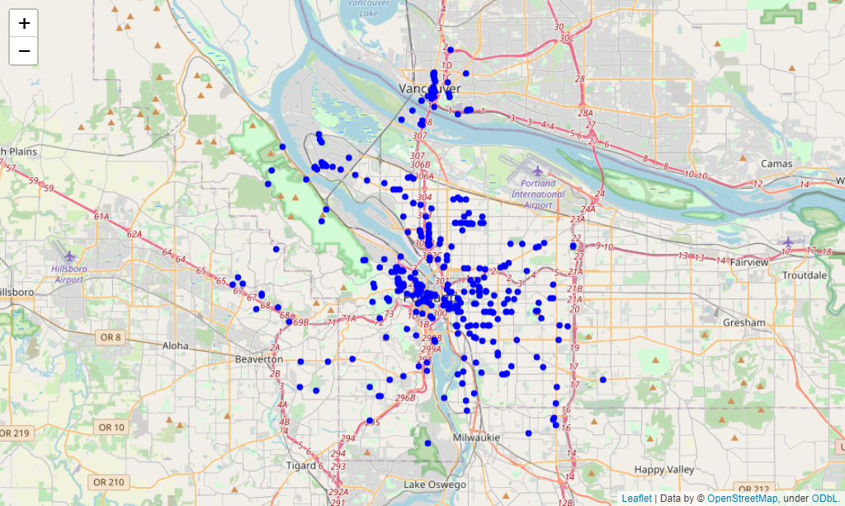
Data cleaning and feature selection
Venue points
Name
Categories (types of venues)
Latitude
Longitude
Requested 5 separately located searches and removed overlapping data to increase data size to 369 points

Slide 5
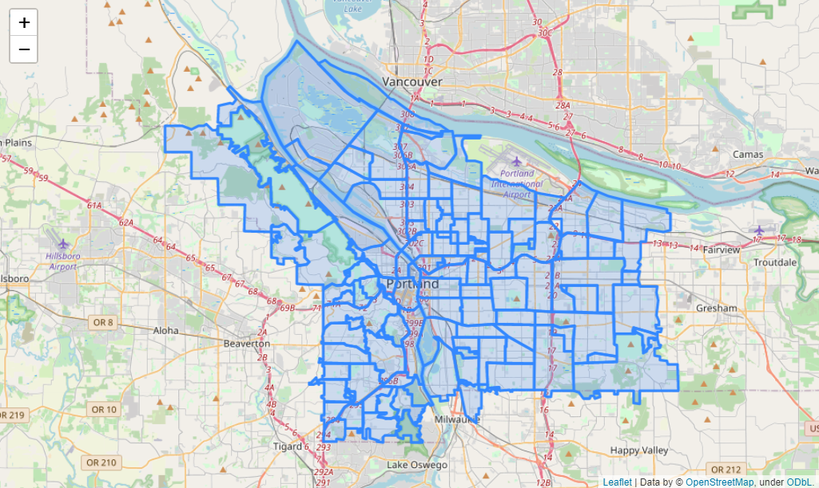
Data cleaning and feature selection
Boundary data
130 areas
Some areas are overlapping neighborhoods
Some areas are “unlisted” or unclaimed by other neighborhoods

Slide 6
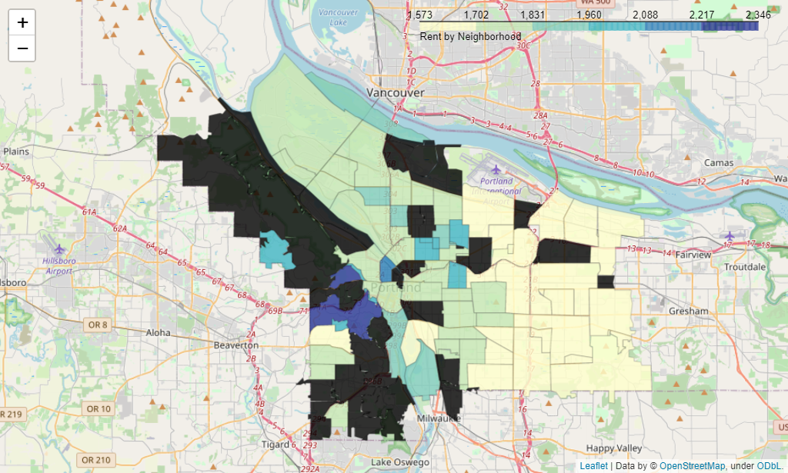
Data cleaning and feature selection
Rent data
Neighborhood
Rent
Shared areas have averaged rent values from available data
Black areas have no data

Slide 7
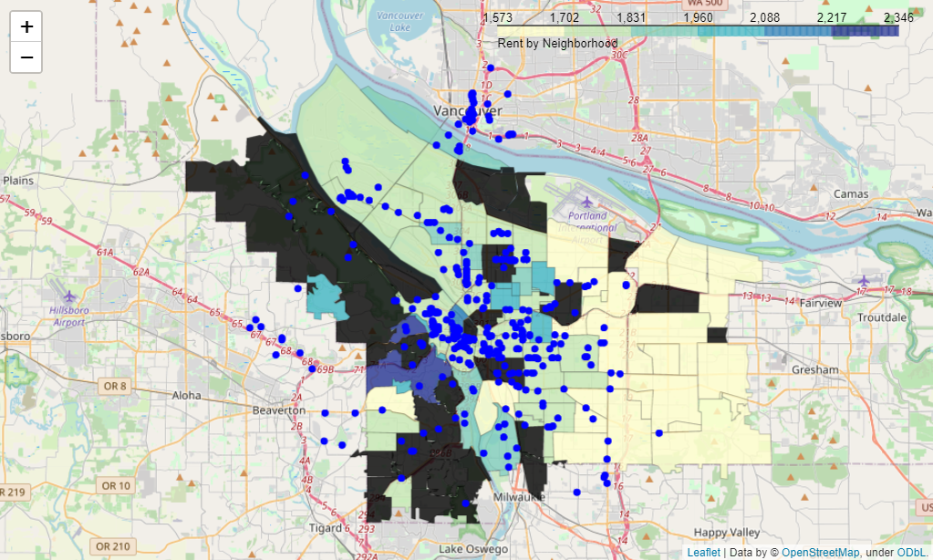
Methodology
Venues outside of the Portland area neighborhoods
Unavailable rent data

Slide 8
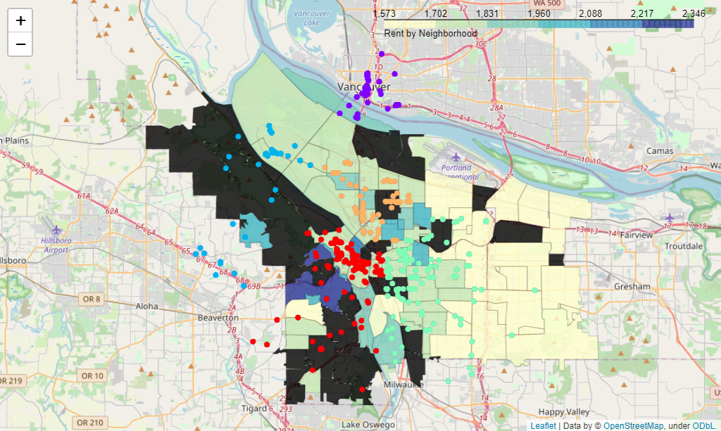
Clustering
k-means clustering
k = 5
5 sections of Portland, OR
North, Northwest, Northeast, Southwest, Southeast

Slide 9
Results
Cluster 1:
Southwest Portland
Includes the downtown area
Cluster 2:
North Portland
Many of the venues are not actually in Portland
Cluster 3:
Northwest Portland
Includes the Forest Park area
Number of venues | 109
Number of unique categories | 58
Rent average | High
Number of venues | 45
Number of unique categories | 43
Rent average | Average
Number of venues | 37
Number of unique categories | 25
Rent average | Average (not much data)

Slide 10
Results
Cluster 4:
Southeast Portland
Across the river from downtown
Has the lowest average for rent
Cluster 5:
Northeast Portland
An average area
Has two areas where venues are clustered
Number of venues | 110
Number of unique categories | 64
Rent average | Low
Number of venues | 45
Number of unique categories | 43
Rent average | Average

Slide 11
Discussion
Average rent
The northern half of Portland
Venues are spread out with not much clustering
Lowest Rent
Southeast, East Portland
Venues are spread out, but there is clustering near the downtown neighborhoods
Highest Rent
Southwest Portland
Includes downtown area
Most of the venues are clustered around here

Slide 12
Recommendation
Southeast Portland if you are sticking to a budget
Has access to many venues, especially if nearby downtown is considered
Has the lowest average rent at $1500 to $2000 per month
Northwest Portland if a budget is not an issue
Some areas have an average rent over $2000 per month
Includes downtown where most of the venues are clustered

Slide 13
Conclusion
Foursquare and Zillow
Foursquare provides much information on venues, but needs some cleaning and data analysis to yield meaningful results from a data science point of view.
Data gathered from Zillow needed cleaning in order to match up with boundary information.
A clear trend in the location of venues and the number of venue categories
The majority of venues are situated in areas of high and low rental data. This may be indicative of their quality, but that is something that could be explored in the future.
Neighborhoods in the southern half of Portland is recommended, depending on the budget.
Business owners, may see less competing local venues in the northern half of Portland, but these areas do not stand out as much.

